Slide 1
HORTATORY EXPOSITION TEXT

Slide 2
WHAT IS HORTATORY EXPOSITION TEXT?
It is a kind of text that presents arguments or reasons to support the speaker/writer’s opinion of an issue
D
D
D
D
D
D

Slide 3
PURPOSE
To persuade the audience that something should or should not be the case
D
D
D
D
D
D

Slide 4
GENERIC STRUCTURE
1) Thesis: statement or announcement of a
concerned issue.
2) Arguments: reasons for the concerned
issue that lead to recommendation.
3) Recommendation: statement of what
should or should not happen or be done
based on the given arguments.

Slide 5
LANGUAGE FEATURES
- Use of temporal connective; firstly, secondly, however, therefore, etc.)
- Use of evaluative words; important, valuable, trustworthy, etc
- Use of the passive voice
- Use of the simple present tense

Slide 6
LANGUAGE FEATURES
- Use of modals and adverbs (e.g. may, must, should, etc.)
- Use of emotive words (e.g. worried, alarmed etc.)
- Use of words that qualify statements (e.g. usual, probably etc.)
- Use of subjective opinions using pronouns I and we

Slide 7
LANGUAGE FEATURES
Generic Structure | Text
Thesis | Mobile phones is not used just for calling, but sending text, taking pictures, accessing internet, and much more. Many students bring their phones to school. For them, mobile phone has many uses. So, mobile phones should not be banned in school. Why do I said that?
Argument 1 | Firstly, students call their parents for other needs. By mobile phone, student can call or their close relative if they need something to be brought to school. In addition, mobile phone can be used to call their children when one of their family were hit by disasters suddenly. And then, student can called their parent to pick her up when want to go home.
Argument 2 | Secondly, increased of knowledge among students. When trying to find answer of difficult task at school, mobile phone can be used as a connecting to search the answer through GPRS or WiFi networks.
Argument 3 | Finally, expand the network of friendship among students. School is the right place to find friend. Average, student been at school about 7 hours or more. So that, a lot of students found their friend in the school environment . Therefore, communication between friends should be kept on of which using a mobile phone
Recommendation | So, I think mobile phone should not be banned in school. But, use your phone in the time and right place so that no one was disturbed.

Slide 8
HORTATORY V.S. ANALYTICAL
What makes hortatory exposition text different from analytical exposition text is the last finalizing step, where the latter is ended with a reiteration.

Slide 9
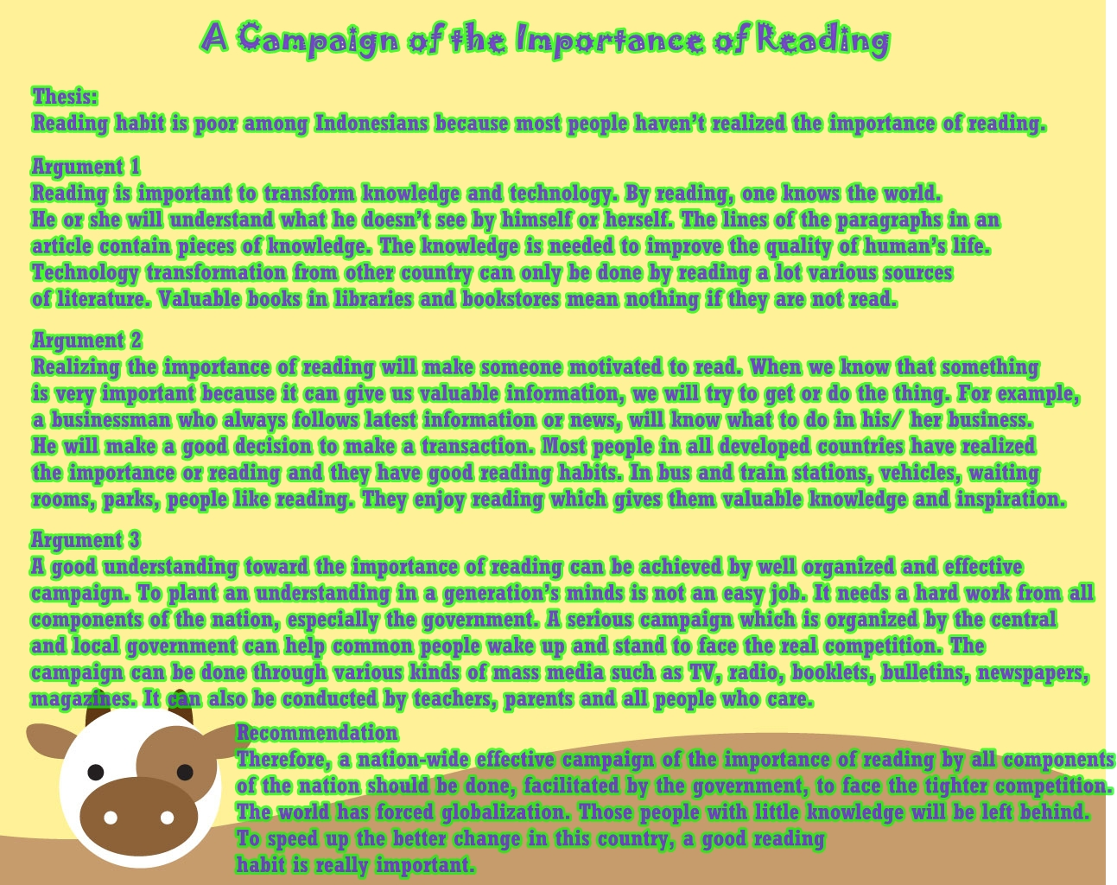
Example

Slide 10
Thank You

